Slide 1


Introduction to Autonomous Vehicle Simulation
Welcome to the world of autonomous vehicle simulation. This presentation will delve into the critical role simulation plays in the development of self-driving cars.
AS
by Apoorv Srivastava

Slide 2

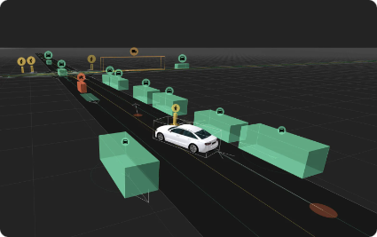
The Importance of Simulation in AV Development
1
Cost-Effective
2
Safety
Simulation significantly reduces the cost and time required for testing and development compared to real-world trials.
It allows for the exploration of risky scenarios and edge cases without endangering real-world drivers and pedestrians.
3
Scalability
4
Controllability
Simulation enables the creation of a diverse range of scenarios and environments for thorough testing and development.
Simulation allows for precise control over the environment, traffic conditions, and vehicle behavior for detailed analysis and optimization.

Slide 3
Key Components of an AV Simulation Environment
Virtual World
Vehicle Model
Sensors and Perception
A 3D digital environment that mimics real-world roads, traffic, and other elements.
A simulation of the vehicle's dynamics, sensors, actuators, and control systems.
Simulation of sensors like cameras, LiDAR, radar, and their outputs to mimic real-world data.

Slide 4

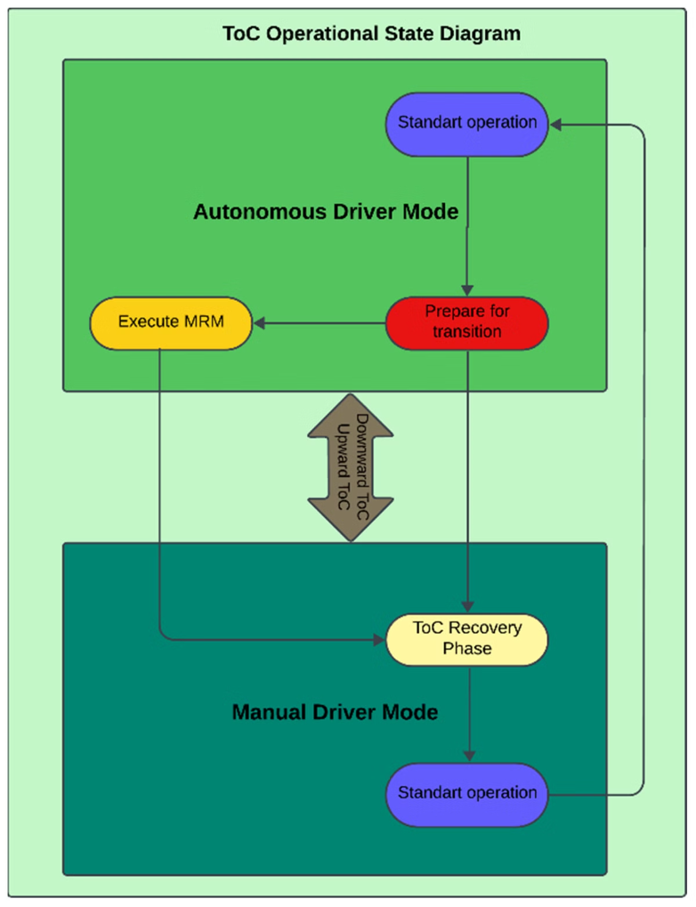
Simulation Scenarios and Use Cases
1
Intersection Navigation
Testing the vehicle's ability to safely navigate complex intersections with pedestrians and other vehicles.
2
Lane Change Maneuvers
Evaluating the vehicle's ability to change lanes safely and efficiently in high-traffic situations.
3
Emergency Braking
Testing the vehicle's response to sudden obstacles and critical situations.
4
Adverse Weather Conditions
Simulating challenging environments like rain, snow, and fog to ensure robustness.

Slide 5


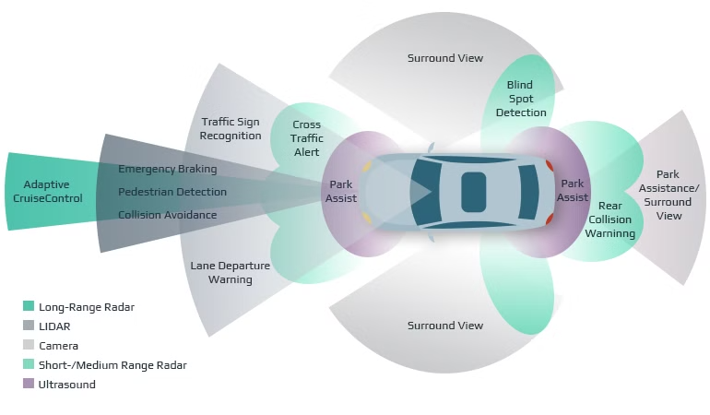


Sensor Modeling and Perception Algorithms
Sensor Data Acquisition
Simulating raw sensor data from cameras, LiDAR, and radar.
Data Processing
Applying perception algorithms to interpret sensor data and identify objects, lanes, and other relevant information.
Decision Making
Utilizing perception outputs to make informed decisions about navigation, lane changes, and other vehicle behaviors.

Slide 6

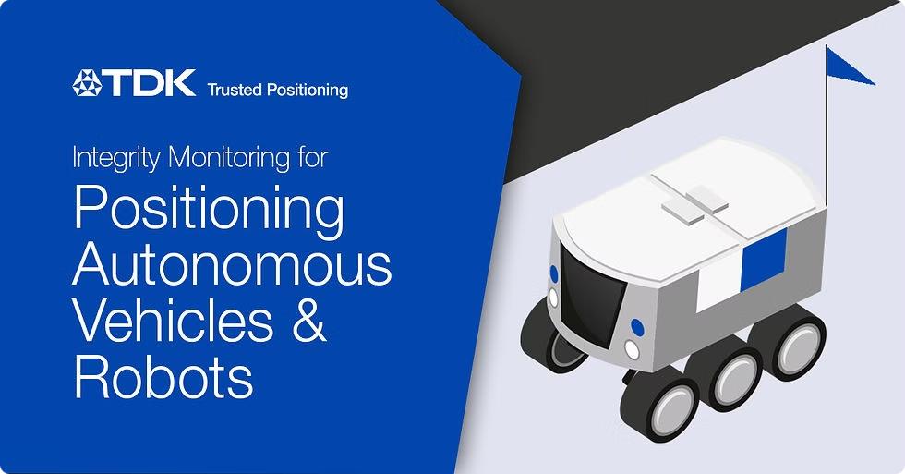
Vehicle Dynamics and Control Strategies
Vehicle Dynamics
Steering
Acceleration
Braking
Control Strategies
Path Planning
Adaptive Cruise Control
Collision Avoidance

Slide 7

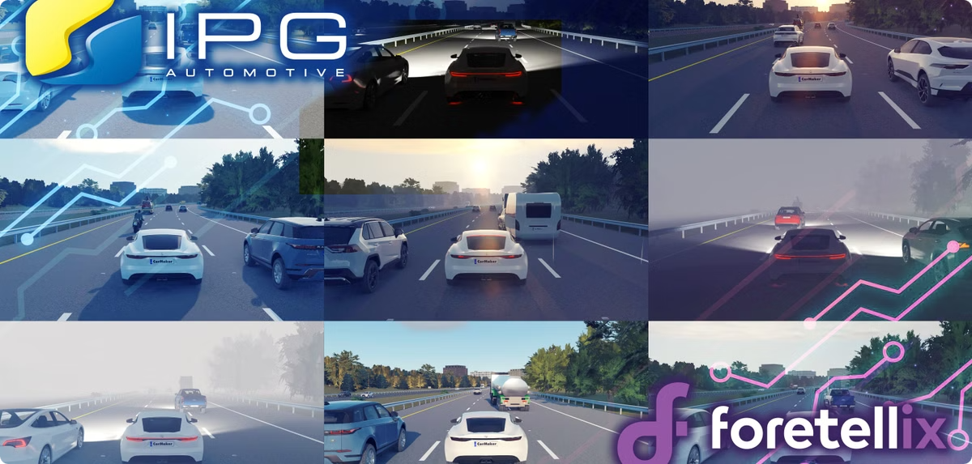
Validation and Testing Frameworks
Hardware-in-the-Loop
Software-in-the-Loop
Integrating real-world sensors and actuators into the simulation environment.
Testing software components independently to ensure their functionality and performance.
Closed-Loop Simulation
Simulating the complete AV system, including sensors, perception, decision-making, and vehicle control.

Slide 8

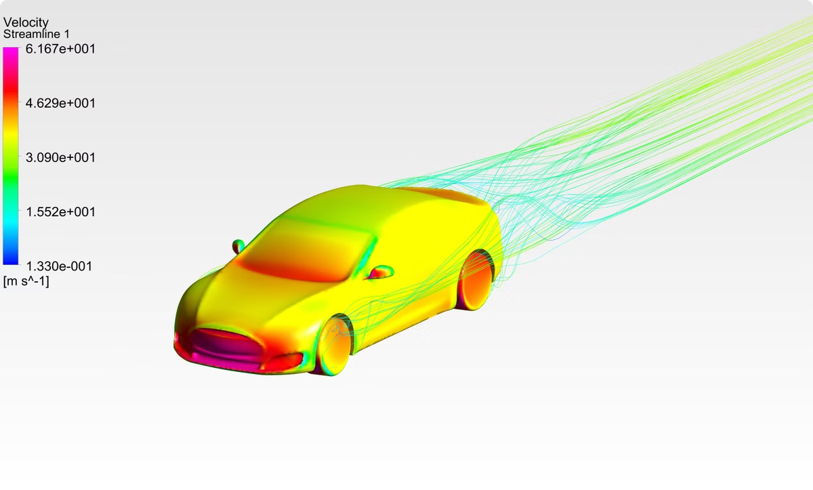
Conclusion and Future Trends
Simulation is an essential tool for developing safe and reliable autonomous vehicles. The future of AV simulation involves advancements in realism, complexity, and integration with real-world testing.

